Slide 1

Computer Communications
& Networks
CSNC-2413
Week: 2
Computer Networking: A Top Down Approach
6th edition
Jim Kurose, Keith Ross
Addison-Wesley
March 2012
Internet Appl Development
Socket Programming
UDP Client-Server
Dr Nauman Mazhar
Faculty of Information Technology (FIT)
University of Central Punjab (UCP)

Slide 2
Chapter 2: outline
2.1 Principles of network applications
2.2 Web and HTTP
2.3 FTP
2.4 Electronic mail
  SMTP, POP3
2.5 DNS
2.6 P2P applications
2.7 Socket programming with UDP and TCP

Slide 3
Some Internet apps
e-mail
web surfing
search engine
P2P file sharing
text messaging
social networking
remote login
streaming stored video
(YouTube, Netflix)
IP radio, TV
multi-user N/W games
voice over IP
(Skype, viber)
real-time video conferencing
…..
How you develop these appls to use the Internet…??

Slide 4
What are Internet Appls
“Applications are processes running on end hosts;
need to share info with each other (IPC)
in order to function properly & provide required services”
Appls within same host…
  perform Inter Process Comm using:
    Pipes, FIFOs, shared memory
Appls on remote hosts…
  perform IPC by exchanging messages using:
    Sockets, RPC

Slide 5
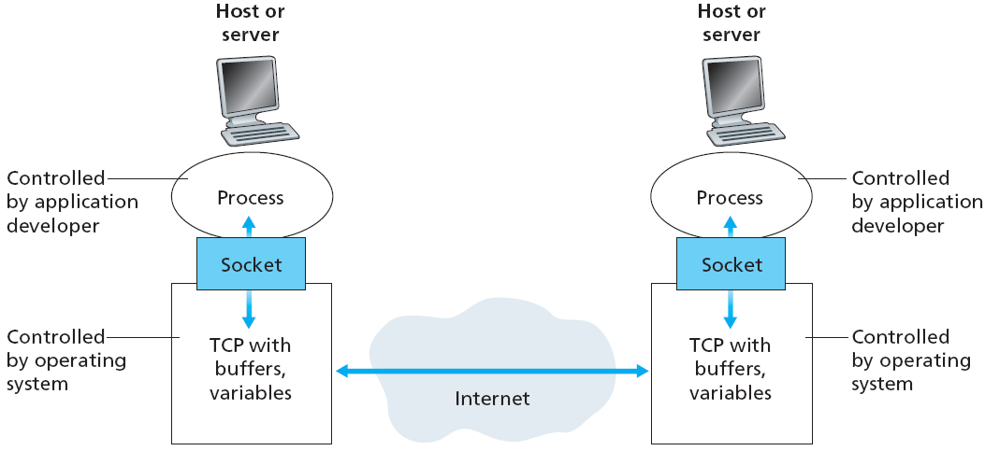
What is a Socket
Socket : Software interface between a process & N/W
  endpoint of bidirectional comm, represented by file descriptor
  each socket has its own, kernel level, send/receive buffers
Remote processes comm by creating/reading/writing sockets

Slide 6
Address of a Process
to receive msgs over Internet,
a process must have an address
each host has a unique
IP address (32 bits)
  but many processes may be
  running on a host
  need another level of addressing – Port Number (16 bits)
Address associated with a process running on a host is the address of its Socket
Socket Address
  (IP address, Port No)
to send HTTP msg to a web server gaia.cs.umass.edu…
  IP address: 128.119.245.12 port number: 80

Slide 7
Internet Appl Development
Appl Layer exposes an API → Socket API
  set of functions provided by C library (glibc on Linux)
  allow processes (appls) to comm across Internet
Socket API mainly provides
interface to Transport
layer:
    TCP : Stream-sockets
    UDP : Datagram-sockets
Used to implement both
client-server & p2p
architectures
Socket Interface
TCP
UDP
IP
Network Access

Slide 8
Client/Server architecture
Client / Server may run on same or different hosts
Client makes Request…
  sends message to server to perform a task
Server Responds…
  performs task & sends back reply
2. Server
handles
request
1. Client sends request
Client
process
Server
process
Resource
4. Client
handles
response
3. Server sends response
Notes:
Both Can run on the same machine

Slide 9
Servers
Server : an appl, runs continuously in background (daemon process), & provides some service
  (web server, mail server, DB server)
Usually started at boot time by OS
  creates a socket
  waits for request, on well known port, associated with a particular
  service
    Port 7: echo server
    Port 23: telnet server
    Port 25: mail server
    Port 53: DNS server
    Port 80: HTTP server
/etc/services
provides list of available services
(Linux machine)

Slide 10
Clients
Client : an appl, launched to access some service on a remote system
  (web browser, ftp client, telnet client, ssh client)
Creates a socket, sends request to server
  does not need to run on well known port number
  usually assigned ephemeral port by kernel
  port number can also be selected by appl
Server – need not know client location
Client – needs to know server location
(IP address, port number)

Slide 11
Socket Address
The pair IP Address & Port makes up a “socket-address”
Client IP address
128.2.194.242
Server IP address
208.216.181.15
Client
Server
3479 is an
ephemeral port allocated by kernel (unix)
80 is a well-known
port associated with
Web servers
Client socket address
128.2.194.242:3479
Server socket address
208.216.181.15:80

Slide 12
TCP & UDP Ports
TCP and UDP port numbers ranges:
  total port numbers available : 65,536 ( 2¹⁶ : 0 - 65535 )
Well Known Ports (0 - 1023)
  used by system processes for well known services
  HTTP: 80, E-mail: 25, DNS: 53, HTTPs: 443
Registered Ports (1024 - 49151)
  used by vendors for common applications
  Web Proxy: 8080, 3306: MySQL, IPSec: 1293, Kaaza: 1214
Dynamic / Ephemeral Ports (49152 - 65535)
  used for client processes
  automatically allocated by kernel on temporary basis

Slide 13
Types of client-server interaction
Socket API can implement two types of client server interactions:
  Iterative Server
    Server handles only one client at a time
  Concurrent Server
    Server handles multiple clients simultaneously
Client/Server can use TCP or UDP protocols…
  UDP → iterative or concurrent server
  TCP → iterative or concurrent server

Slide 14
UDP Client Server
Notes:
The long-distance carrier system provided in the United States and throughout the world was designed to transmit voice signals over high-capacity transmission links, such as optical fiber, coaxial cable, and microwave. Part of the evolution of these telecommunications networks to digital technology has been the adoption of synchronous TDM transmission structures. In the United States, AT&T developed a hierarchy of TDM structures of various capacities; this structure is used in Canada and Japan as well as the United States. A similar, but unfortunately not identical, hierarchy has been adopted internationally under the auspices of ITU-T.
The basis of the TDM hierarchy (in North America and Japan) is the DS-1 transmission format. The same DS-1 format is used to provide both multiplexed voice and digital data services. Above the DS-1 data rate of 1.544 Mbps, higher-level multiplexing is achieved by interleaving bits from DS-1 inputs. For example, the DS-2 transmission system combines four DS-1 inputs into a 6.312-Mbps stream. Data from the four sources are interleaved 12 bits at a time. Note that 1.544 × 4 = 6.176 Mbps. The remaining capacity is used for framing and control bits.

Slide 15
UDP Iterative Server
Server:
  create socket at server side
  bind with its IP address & Port number
Client:
  create socket at client side
Client/Server:
  sendto/recvfrom user data
  close the connection

Slide 16
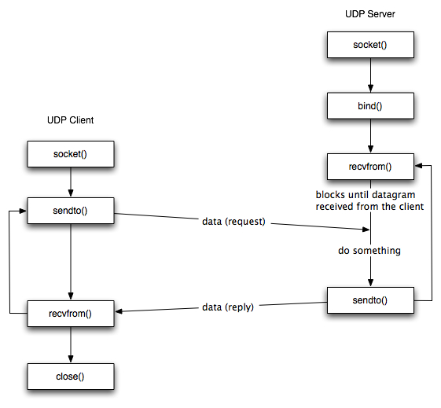
UDP Iterative Server

Slide 17
Example Code;
UDP Iterative Server

Slide 18
server.c: (include, define)
#include <stdio.h>
#include <stdlib.h>
#include <errno.h>
#include <string.h>
#include <sys/types.h>
#include <netinet/in.h>
#include <sys/socket.h>
#include <sys/wait.h>
#define SERV_PORT 1233 /* my well-known port */
#define MAXDATASIZE 100 /* max data to receive in one pkt*/

Slide 19
server.c: (main, socket)
int main (void)
{
int sockfd; /* listen on sockfd */
struct sockaddr_in my_addr; /* server addr struct */
struct sockaddr_in cli_addr; /* client addr struct */
int sin_size; /* addr struct size */
int numbytes; /* number of bytes captured*/
char buf [MAXDATASIZE];
if ((sockfd = socket (AF_INET, SOCK_DGRAM, 0)) == -1) {
perror("socket");
exit(1);
}

Slide 20
server.c: (bind)
my_addr.sin_family = AF_INET; /* addr family*/
my_addr.sin_port = htons (SERV_PORT); /* convert to short, network
byte order */
my_addr.sin_addr.s_addr =(INADDR_ANY); /* automatically fill with
my IP */
bzero (&(my_addr.sin_zero), 8); /* zero rest of struct */
if (bind (sockfd, (struct sockaddr *)&my_addr, sizeof (struct sockaddr) ) == -1) {
perror("bind");
exit(1);
}

Slide 21
server.c: (recvfrom)
while(1) { /* always true */
sin_size = sizeof (struct sockaddr_in);
if ( (numbytes = recvfrom (sockfd, buf, MAXDATASIZE-1, 0,
(struct sockaddr *) &cli_addr, &sin_size) ) == -1) {
perror ("recv"); exit (1);
}
buf [numbytes] = '\0';
printf ("Server received: %s \n", buf);
} /* while loop ends here */
return 0;
} /* main function ends here */

Slide 22
Example Code: UDP Client

Slide 23
client.c: (include, define)
#include <stdio.h>
#include <stdlib.h>
#include <errno.h>
#include <string.h>
#include <netdb.h>
#include <sys/types.h>
#include <netinet/in.h>
#include <sys/socket.h>
#define SERV_PORT 1233 /* server’s well-known port */
#define SERV_IP “127.0.0.1” /* server’s IP Addr*/
#define MAXDATASIZE 100 /* max number of bytes to send */

Slide 24
client.c: (main, socket)
int main (void)
{
int sockfd, numbytes;
char buf [MAXDATASIZE];
struct sockaddr_in serv_addr; /* server addr struct */
if ( (sockfd = socket(AF_INET, SOCK_DGRAM, 0)) == -1 ) {
perror (“socket”); exit (1);
}
serv_addr.sin_family = AF_INET; /* addr family*/
serv_addr.sin_port = htons (SERV_PORT);/* to short net byte order*/
serv_addr.sin_addr.s_addr = inet_addr (SERV_IP); /* server IP*/
bzero (&(serv_addr.sin_zero), 8); /* zero rest of struct */

Slide 25
client.c: (sendto)
while (1) { /* always true */
sin_size = sizeof (struct sockaddr_in);
if ( sendto (sockfd, “Hello World! \n”, 14, 0, (struct sockaddr *)
&serv_addr, sin_size) == -1) {
perror ("recv");
exit (1);
}
sleep (1);
} /* while loop ends here */
return 0;
} /* main function ends here */

Slide 26
Socket Programming Calls - for UDP

Slide 27
Create Socket
int socket (int family, int type, int protocol);
creates a socket
returns socket descriptor; or -1 on error, and sets errno
family address family / protocol family
  AF_INET for IPv4, AF_INET6 for IPv6
type type of communication
  SOCK_DGRAM for UDP
  SOCK_STREAM for TCP
  SOCK_RAW for Raw socket
protocol protocol within family
  typically 0 (except for raw socket)

Slide 28
Bind the Socket
int bind (int sockfd, struct sockaddr* serverAddr, int addrlen);
binds a socket to a local IP address & port number
returns 0 on success; -1 on failure and sets errno
sockfd socket descriptor (returned from socket)
serverAddr includes IP address and port number
      IP address set by kernel if value passed is INADDR_ANY,
      else set by caller
      port number set by kernel if value passed is 0,
      else set by caller
addrlen length of address structure
      sizeof (struct sockaddr_in)

Slide 29
Send Data
int sendto (int sockfd, char* buf, size_t nbytes, int flags,
struct sockaddr* to, int addrlen);
write data to a datagram socket (UDP)
returns number of bytes written; or -1 and sets errno on failure
sockfd : socket descriptor
buf : data buffer to send from
nbytes : number of bytes to try to write
flags : set to 0 (for normal sending behavior, no special options)
to : socket addr structure (IP & Port) where to send data
addrlen : length of addr structure

Slide 30
Receive Data
int recvfrom (int sockfd, char* buf, size_t nbytes, int flags,
struct sockaddr* from, int* addrlen);
read data from a datagram socket (UDP)
returns number of bytes read; or -1 and sets errno on failure
sockfd : socket descriptor
buf : buffer to recv data
nbytes : number of bytes to read
flags : set to 0 (for normal receiving behavior, no special options)
from : socket addr structure is filled with IP & Port of sender host
(when function returns)
addrlen : length of addr structure

Slide 31
Close Connection
int close (int sockfd);
Socket marked as closed, no more read/write calls
Returns 0 on success; -1 on failure & sets errno
sockfd : socket descriptor

Slide 32
Socket Address Structures

Slide 33
Socket Address Structure
Used in socket API functions as argument
  pointer to socket address structure
Each protocol defines its own Socket Address Structure
  IPv4, IPv6

Slide 34
IPv4 Socket Address Structures
struct sockaddr_in {
uint8_t sin_len; /* length of structure (16) */
sa_family_t sin_family; /* AF_INET */
in_port_t sin_port; /* 16 bit TCP/UDP port number */
/* network byte ordered */
struct in_addr sin_addr; /* 32bit IPv4 addr net byte ordered */
char sin_zero [8]; /* unused */
}; /* included in <netinet/in.h> */
struct in_addr {
in_addr_t s_addr; /* 32bit IPv4 address */
}; /* network byte ordered */

Slide 35
Generic Socket Address Structure
To deal with socket address structures from any of the supported protocol families – IPv4, IPv6
<sys/socket.h> defines Generic Socket address structure
struct sockaddr {
uint8_t sa_len;
sa_family_t sa_family; /* address family: AF_INET */
char sa_data [14]; /* protocol specific address */
}

Slide 36
Use of Generic Socket Address Structure
int bind (int , struct sockaddr * , socklen_t);
Example:
struct sockaddr_in serv; /* IPv4 socket address structure */
/* fill in serv{} */
bind (sockfd, (struct sockaddr *) &serv, sizeof (serv) );
The only use of this structure is to…
cast pointers to protocol-specific structures

Slide 37
Address Conversion Functions

Slide 38
Functions: inet_aton, inet_addr, inet_ntoa
Convert internet address between ASCII string (dotted decimal notation) and binary values (network byte ordered)
Conversion functions specific to IPv4 addresses
Cannot be used for IPv6 addresses

Slide 39
Functions: inet_aton, inet_addr, inet_ntoa
#include<arpa/inet.h>
int inet_aton (const char *strptr, struct in_addr *addrptr);
  ASCII to numeric conversion
  return : 1 if string was valid, 0 on error
struct sockaddr_in my_addr;
inet_aton (strptr, &my_addr.sin_addr);
in_addr_t inet_addr (const char *strptr);
  convert from dotted form to numeric representation
  return : 32bit binary, network byte ordered, IPv4 address;
  INADDR_NONE if error
struct sockaddr_in my_addr;
my_addr.sin_addr.s_addr = inet_addr (strptr);

Slide 40
Functions: inet_aton, inet_addr, inet_ntoa
#include<arpa/inet.h>
char *inet_ntoa (struct in_addr inaddr);
  convert numeric address to ASCII format
  return : pointer to dotted-decimal string
char *strptr;
strptr = inet_ntoa (my_addr. sin_addr); // my_addr is a struct of
// type sockaddr_in

Slide 41
Byte Ordering Functions

Slide 42
Byte Order
Different computer architectures use different byte orders to represent multibyte values
Byte Order : which end of a multibyte value (little end or big end) is stored at the starting memory address
16 bit integer…
Low Byte
Address A
High Byte
Little Endian
Big
Endian
High Byte
Address A+1
Low Byte

Slide 43
Byte Order
Suppose a Big Endian host sends a 16 bit integer with the value 2:
A Little Endian host will think it got the number 512:
0000 0000
0000 0010
0000 0000
0000 0010

Slide 44
Byte Ordering
Network Byte Order - the data format used in networks
  not dependant on CPU and OS
  same as Big Endian
Host may be little or big endian
To communicate with each other, hosts must translate :
  host byte order to network byte order when
  sending data
  network byte order to host byte order when
  receiving data

Slide 45
Byte Ordering Functions
  Conversion functions for host/network byte order
    work on 16 bit (short) and 32 bit (long) values
  convert network addresses, ports, …
  uint16_t htons (uint16_t host16bitvalue);
  uint32_t htonl (uint32_t host32bitvalue);
  uint16_t ntohs (uint16_t net16bitvalue);
  uint32_t ntohl (uint32_t net32bitvalue);
Header file : ‘netinet/in.h’
h : host n : network s : short (16bit) l : long (32bit)
Return : value in network byte order
Return : value in host byte order

